Slide 1

Global Net Overseas Deputation Process
1) Employee raises travel request, specifying travel plan of self and dependants.
2) Source RM approves travel plan.
3) Destination RM approves travel plan.
4) Travel department fix travel plan (travel itinerary).
5) Travel department enters the finalized travel dates and specifies the Visa information (Visa-tagging)
6) FYI Notification to travel department to issue ticket.
7) FYI Notification to accounts dept. to issue Forex.
8) Notification to destination RM to confirm reporting date
9) FYI notification to source RM about confirmation of employee reporting.

Slide 2
Global Net Overseas Deputation Process
Global NET
Emp. Travel
Request with
Details of Dependants,
Detailed travel Plan.
To source RM for approval
To destination RM for approval
The functional block diagram of the process flow from G-NET to Ultimatix-HR
Add data to interface table for HR process initiation
Interface Tables

Slide 3
Global Net Overseas Deputation Process
HR - Ultimatix
Create records in details of people traveling
Notf. to travel dept. for visa tagging & to add ticket details
The functional block diagram of the process flow in Ultimatix-HR
Notn. to travel dept. for issuing tickets
Update overseas dep. status & insurance details
Notn. to destination RM to add reporting date
FYI Notf. To overseas finance for initial allowance payment
Activation in GlobalNet and
FYI notn. to source RM to about employee’s reporting.
End

Slide 4
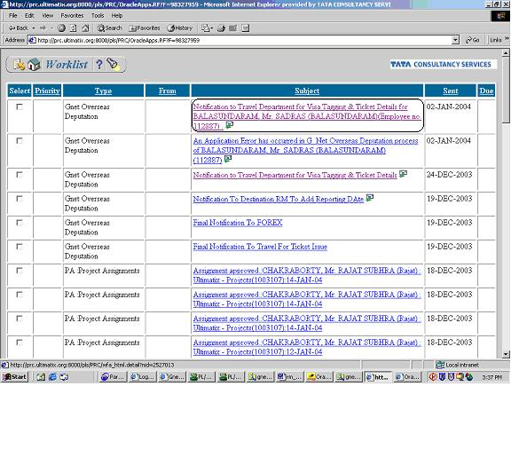
Global Net Overseas Deputation Process
The notification in the worklist of the travel department.

Slide 5
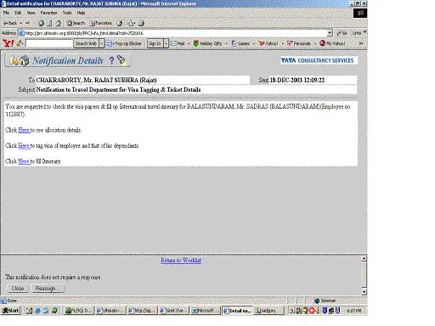
Global Net Overseas Deputation Process
This notification will be sent to the worklist of the travel department.
The are three hyperlinks available in the notification body to
1) Display the page to see allocation
details.
2) Page to tag visa of employee
and that of his/her dependants.
3) Page to fill travel details.
After completing visa tagging and entering travel details using the above links, the recipient has to respond to the notification as “DONE”.

Slide 6
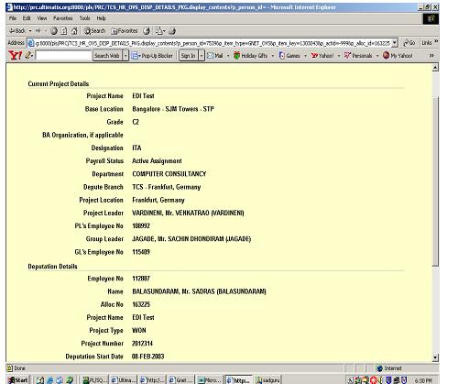
Global Net Overseas Deputation Process
The page will be displayed if link #1 is chosen

Slide 7
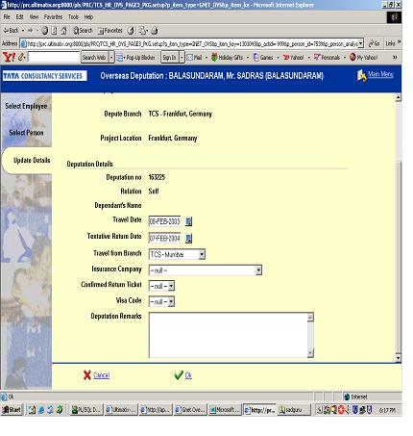
Global Net Overseas Deputation Process
The page1 will be displayed if link #2 is chosen for tagging visa of the employee

Slide 8
Global Net Overseas Deputation Process
The page2 will be displayed upon clicking the “NEXT” button in page#1 to tag the visa of the employee and following details will have to entered.
Travel date.
Tentative return date.
Select travel from branch .
Select insurance company.
Confirmed return ticket.
Visa code.
Deputation remarks.
Click OK

Slide 9
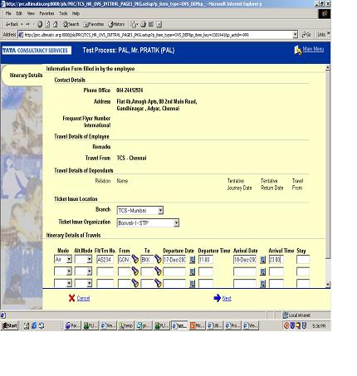
Global Net Overseas Deputation Process
The page1 will be displayed if link #3 is chosen for adding travel details.The following fields are to be entered.
Ticket issue organization
Mode of travel(Train/Air/Bus)
Flight / Train number
Travel from City
Travel to City
Departure date
Departure time
Arrival date at destination
Arrival Time
Number of days of stay (optional)
Press “Next”

Slide 10
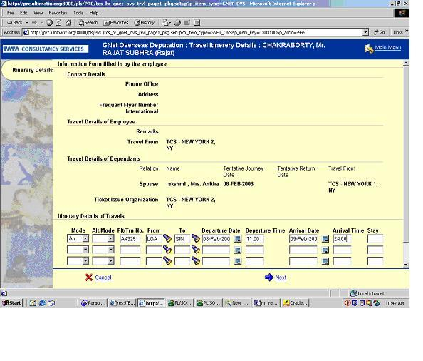
Global Net Overseas Deputation Process
The page2 will be displayed after “NEXT” button is clicked from page1 for adding travel details.
Verify the data entered in the previous page.If data is found to be correct then Click “OK” else Press back to make changes in page1.

Slide 11
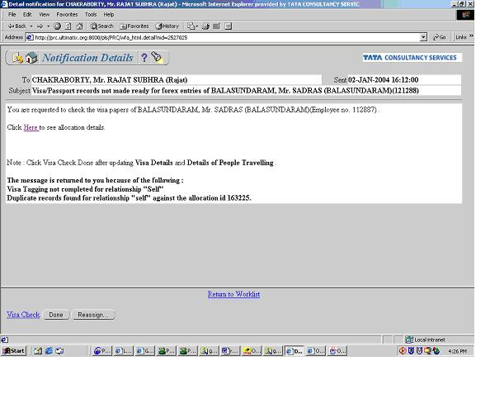
Global Net Overseas Deputation Process
In case visa tagging is not complete, and there is a error the notification details will be displayed as shown.

Slide 12
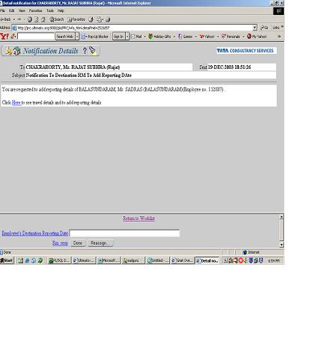
Global Net Overseas Deputation Process
Notification to approver provided by G-NET
The notification will be in the worklist of the destination approver provided by G-NET.
There is a link provided in the notification body
to display the page, to see arrival details and to add reporting details of the employee.

Slide 13
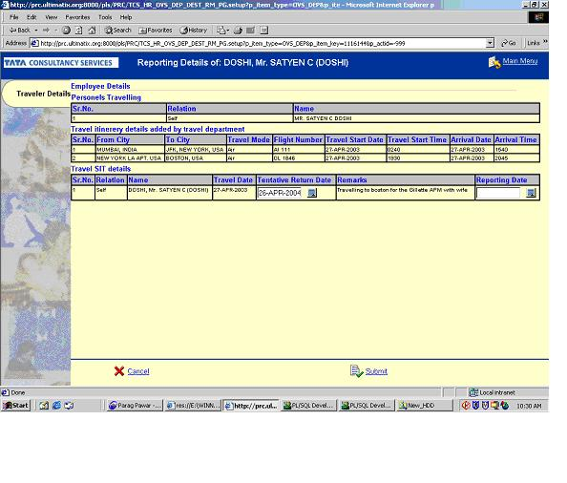
Global Net Overseas Deputation Process
Page to Add reporting details by destination approver provided by G-NET
Check if the tentative return date is correct,if not then it can be changed.
Add reporting date for the employee and his dependents(if they are traveling).
3) Click on submit.

Slide 14
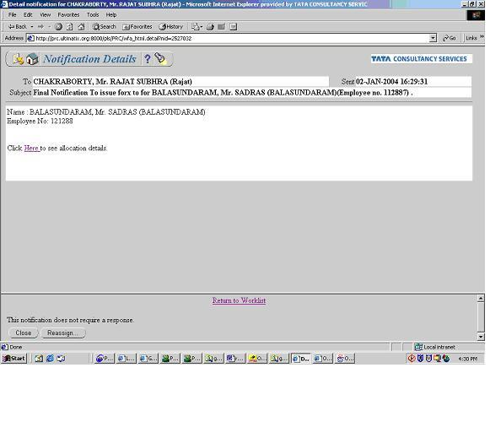
Global Net Overseas Deputation Process
FYI Notification to issue Forex

